Slide 1


Pediatric Basic Life Support
© 2015 American Heart Association
http://www.circulationaha.org

Slide 2

Pediatric Chain of Survival
1.prevention,
2.early CPR,
3.prompt access to the emergency response system,
4.rapid PALS,
5. integrated post– cardiac arrest care.
the first 3 links: BLS
Notes:
1- since injury is the leading cause of death in children over 1 year of age and motor vehicle crashes are the most common cause of fatal childhood injuries; targeted interventions, such as the use of child passenger safety seats, can reduce the risk of death.

Slide 3
Overall about 6% of children who suffer an out-of-hospital cardiac arrest and 8% of those who receive prehospital emergency response resuscitation survive

Slide 4
RESCUERS
Lay Rescuers
Healthcare Providers

Slide 5
VICTIMS
INFANT:<1Y/O
CHILD:1Y/O until puberty (defined as breast development in females and the presence of axillary hair in males)
ADULT:beyond puberty

Slide 6
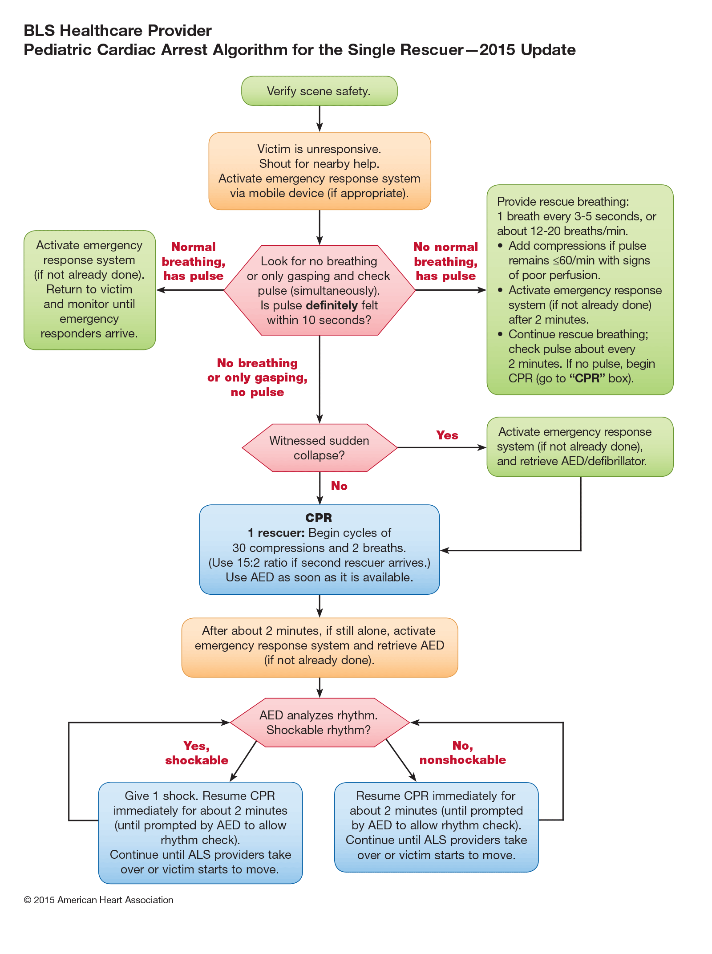

Slide 7
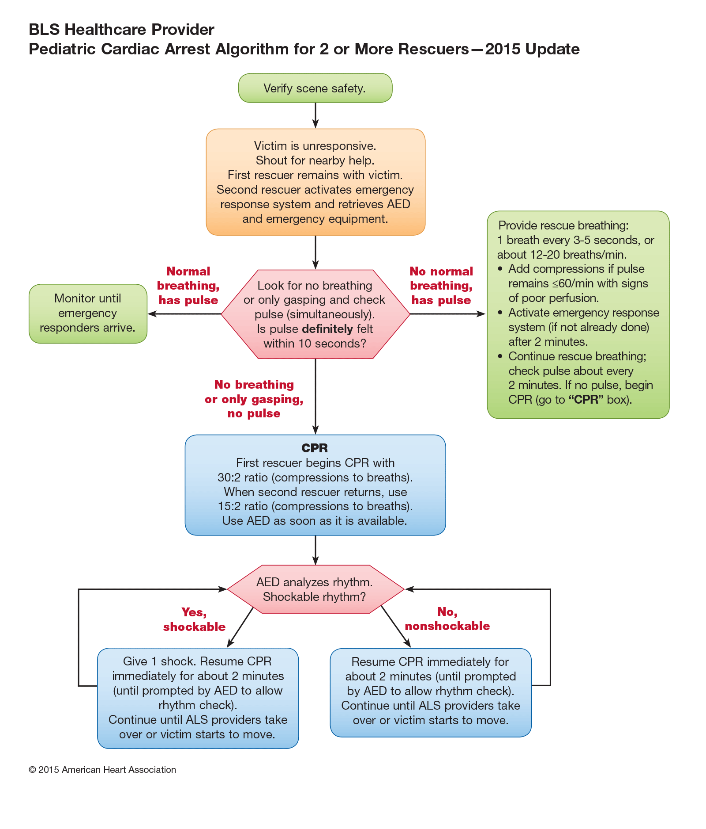

Slide 8
Safety
Safety of Rescuer & Victim
Always make sure that the area is safe for you & the victim
Move a victim only to ensure the victim’s safety
Notes:
,a high way, a burning building ,

Slide 9
Assess Responsiveness
Call the child’s name if you know it,or ask loudly: “Are you okay?”
Tap the victim (the bottom of the foot is a good place in infant & )
Look for movement, answering or moaning

Slide 10
Responsive child
he or she will answer or move
Checking the child for any injuries or need of medical assistance
Calling EMS

Slide 11
Nonresponsive
(Shout for help,check breath)
Regular breathing
No evidence of trauma
Breathing but respiratory distress
Recovery position
Call EMS
Remain him/her in a position that is most comfortable
Call EMS

Slide 12
Recovery Position
If the child is breathing & there is no evidence of trauma: turn the child onto the side (recovery position).

Slide 13
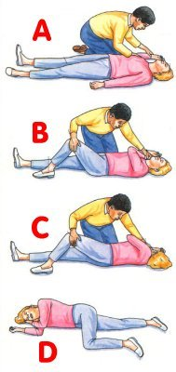
Recovery Position

Slide 14
Unresponsive
No Breathing
Shout for help & start CPR
Lone rescuer, continue CPR for 5 cycles (about 2 min)then call EMS
Two rescuers:one continues CPR and other call EMS

Slide 15
Unresponsive child
If you are alone & there is no evidence of trauma, you may carry a small child with you to the telephone
If the child must be moved for safety reasons, support the head & body to minimize turning, bending, or twisting of the head & neck

Slide 16
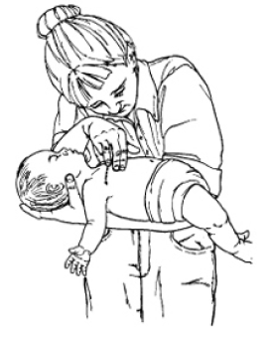
carrying a small child to the telephone

Slide 17
Activate the EMS System & Get the
AED
If the arrest is witnessed & sudden (e.g., an athlete who collapses on the playing field), a lone healthcare provider should activate the EMS system & get an AED before starting CPR
If two rescuers, one continues CPR and the other activates EMS
If one rescuer and the arrest is not witnessed, continue CPR for 2 min then activate EMS

Slide 18
Position the Victim
If the victim is unresponsive, make sure that the victim is in a supine position on a flat, hard surface, such as a sturdy table, the floor, or the ground
If you must turn the victim, minimize turning or twisting of the head & neck

Slide 19
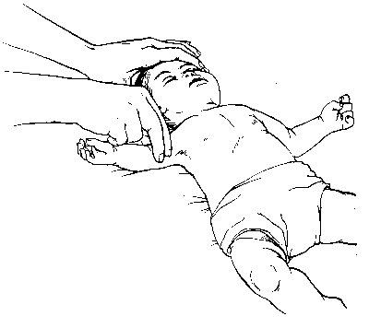
Pulse Check
Brachial in an infant & carotid or femoral in a child
Take no more than 10 s
Profound bradycardia [PR < 60 bpm + signs of poor perfusion (i.e., pallor, cyanosis)] despite oxygenation & ventilation: chest compressions

Slide 20
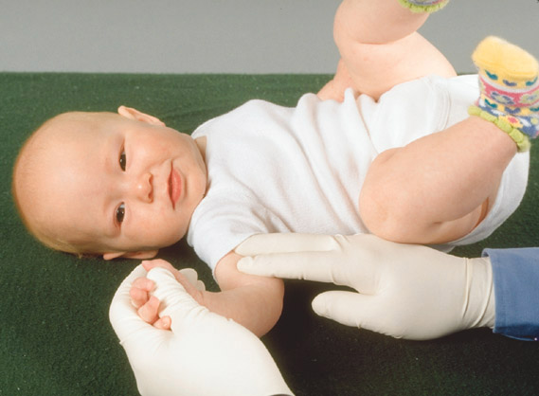
BRACHIAL PULSE CHECK

Slide 21
Definite pulse
Give one breath every 3-5 seconds(12-20/min)
Open the airway using a head tilt–chin lift maneuver or jaw thrust
(lay rescuers use head tilt–chin lift maneuver for both injured and non injured victims)

Slide 22
No pulse
Do chest compression & breathing

Slide 23
When check pulse again
Reassess the pulse about every 2 minutes but spend no more than 10 seconds

Slide 24
Chest Compressions
Compress the lower half of the sternum
Do not compress over the xiphoid
After each compression allow the chest to recoil fully to improve blood flow into the heart
Lift your hand slightly off the chest at the end of each compression

Slide 25
Chest Compressions
“Push hard”: to depress the chest approximately 1/3 the anterior-posterior diameter of the chest
Compress 4cm in infant & 5 cm in >1yr
“Push fast”: at a rate of approximately 120 compressions/min
Release completely to allow the chest to fully recoil
Minimize interruptions in chest compressions

Slide 26
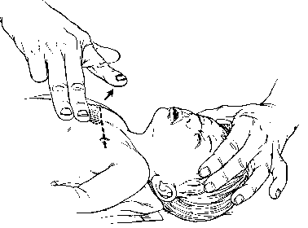
2-finger Chest Compression Technique in Infant
For lay rescuers & lone rescuers
Place 2 fingers just below the inter-mammary line

Slide 27
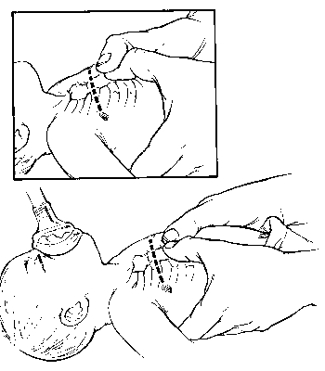
Hand Position for Chest Encirclement
Encircle the infant’s chest with both hands; spread your fingers around the thorax, & place your thumbs together over the lower half of the sternum
Forcefully compress the sternum with your thumbs .
Notes:
The 2-thumb–encircling hands technique is preferred over the 2-finger technique because it produces higher coronary artery perfusion pressure, results more consistently in appropriate depth or force of compression,and may generate higher systolic and diastolic pressures

Slide 28
2 Thumb–encircling Hands Chest Compression in Infant (2 Rescuers)

Slide 29
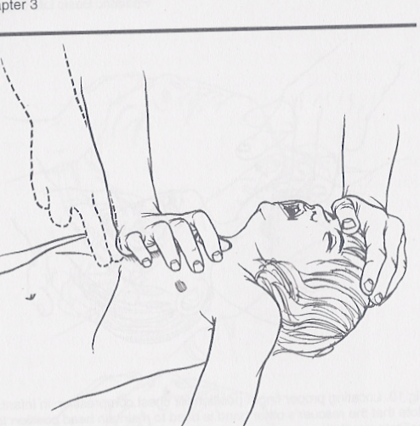
Chest Compressions
In older children → the lower third of the sternum
Maintain continuous head tilt with hand on forehead
One hand
120/minute
1/3 of chest
Carotid pulse is used to check for pulse

Slide 30
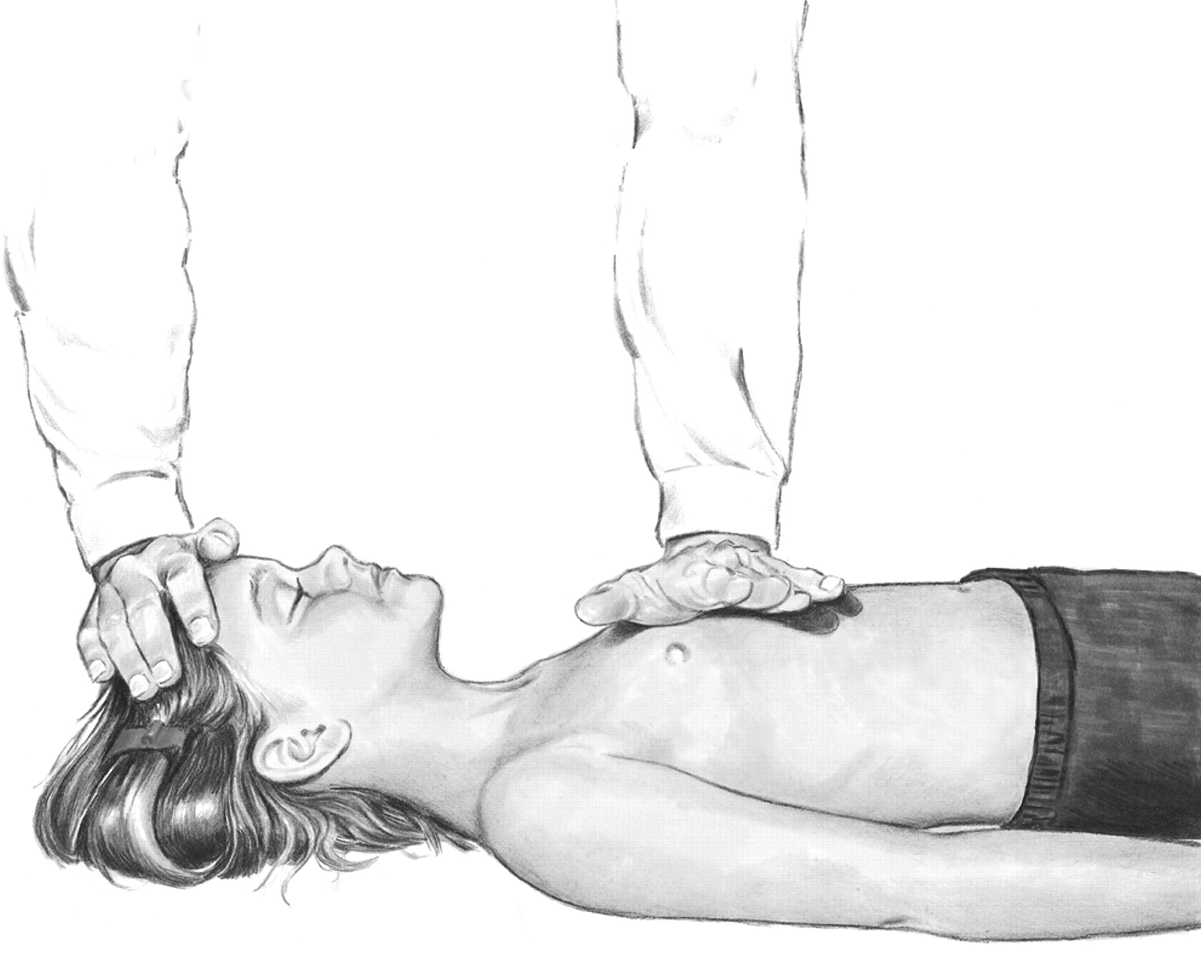
One-hand chest compression technique in child (1-8) Yr
Copyright ©2015 American Heart Association

Slide 31
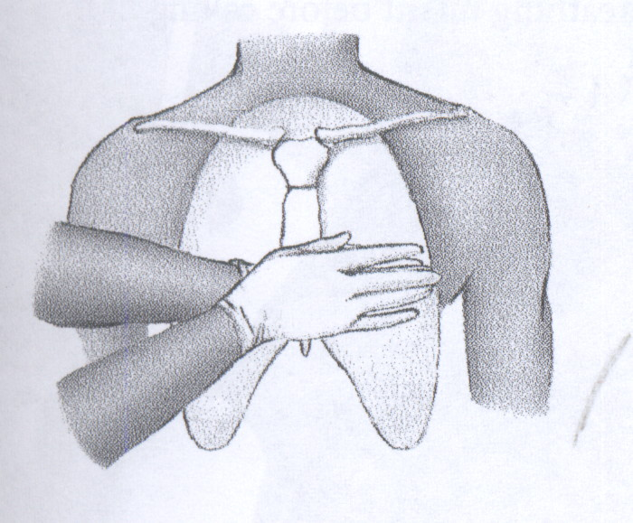

Slide 32
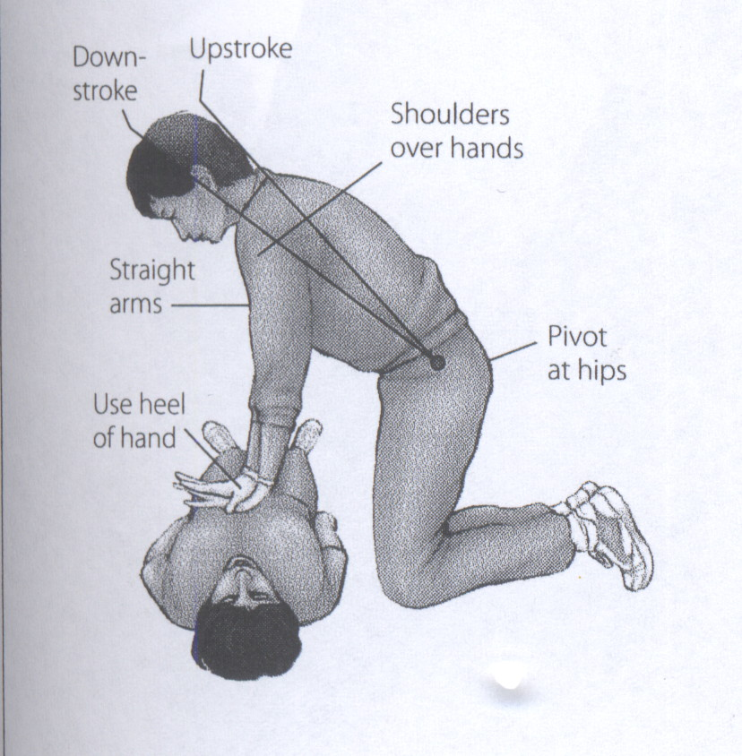

Slide 33
Ventilations
Inadequate Breathing With Pulse
After 30 compressions (15 compressions if 2 rescuers),open the airway with a head tilt– chin lift and give 2breaths
If there is evidence of trauma that suggests spinal injury, use a jaw thrust without head tilt to open the airway

Slide 34
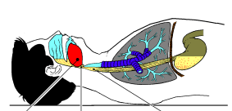
Nonresponsive tongue & epiglottis block airway

Slide 35
Cervical Spinal Precautions
For a healthcare provider with suspecting a C-spine injury: jaw thrust without head tilt
Use a head tilt– chin lift maneuver if the jaw thrust does not open the airway
a lay rescuer uses a head tilt–chin lift maneuver for both injured and noninjured victims
Notes:
a lay rescuer uses a head tilt–chin lift maneuver for both injured and noninjured victims

Slide 36
Opening the Airway
Airway obstruction produced by the tongue & the epiglottis
Relief by head-tilt/chin-lift

Slide 37
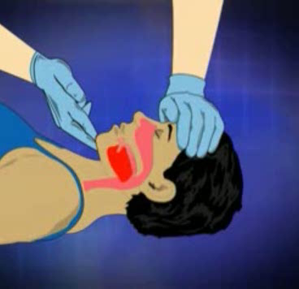

Slide 38
Jaw-thrust Maneuver

Slide 39
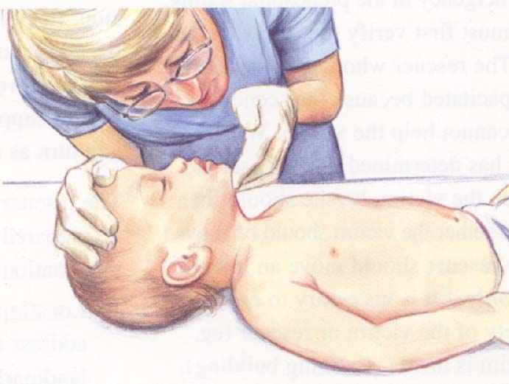
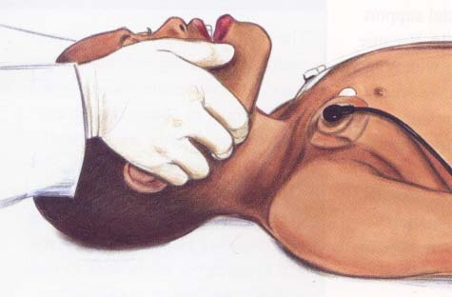
Airway Management
Head Tilt-Chin Lift
Jaw Thrust
Avoid extreme hyperextension

Slide 40
Correct (sniffing) position for maximal airway patency

Slide 41
Rescue Breathing
Maintain an open airway & give 2 breaths
  Make sure that the breaths are effective (i.e., the chest rises)
  If the chest does not rise, reposition the head, make a better seal, & try again

Slide 42
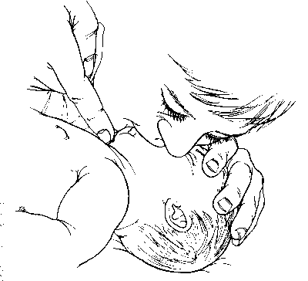
Comments on Technique
In an infant, use a mouth-to–mouth-&-nose technique
In a child, use a mouth-to-mouth technique
If you use the mouth-to-mouth technique, pinch the nose closed
If you use the mouth-to-nose technique, close the mouth

Slide 43
Barrier Devices
Despite its safety, some healthcare providers & lay rescuers may hesitate to give mouth-to-mouth rescue breathing & prefer to use a barrier device
Barrier devices have not reduced the risk of transmission of infection, & some may increase resistance to air flow
If you use a barrier device, do not delay rescue breathing

Slide 44
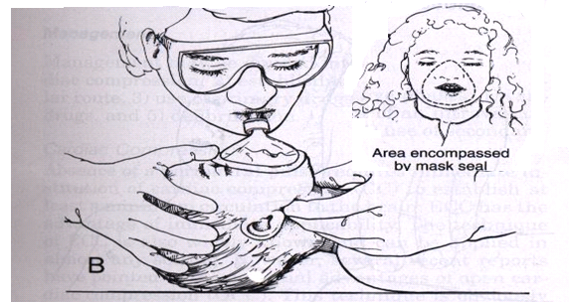

Slide 45
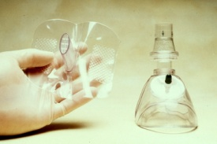

Slide 46
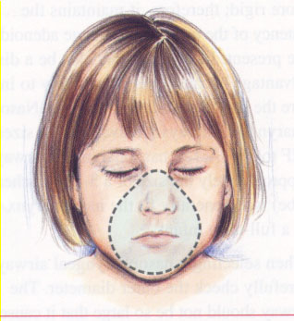
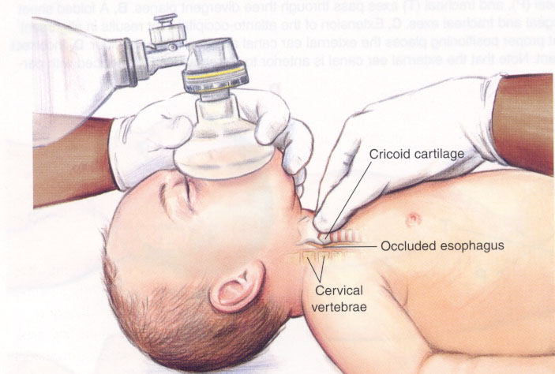
Bag-Mask Ventilation
Can be as effective as ETI & safer when providing ventilation for short periods
In the out-of-hospital setting, preferentially ventilate & oxygenate infants & children with a bag & mask rather than attempt intubation if transport time is short

Slide 47
Ventilation Bags
Use a self-inflating bag with a volume of at least 450-500 ml
Even with an oxygen inflow of 10 L/min, the concentration of delivered oxygen varies from 30-80%
To deliver a high oxygen concentration (60-95%), attach an oxygen reservoir to the self-inflating bag
You must maintain an oxygen flow of 10-15 L/min into a reservoir attached to a pediatric bag & a flow of at least 15 L/min into an adult bag.

Slide 48
Precautions
Avoid hyperventilation; use only the force & VT necessary to make the chest rise
Give each breath over 1 s.

Slide 49
Excessive Ventilation
Impedes venous return & therefore decreases CO, & coronary perfusion by increasing intra-thoracic pressure
Causes air trapping & baro-trauma in patients with small airway obstruction
Increases the risk of regurgitation & aspiration

Slide 50
Gastric Inflation & Cricoid Pressure
Apply cricoid pressure
Do this only in an unresponsive victim & if there is a second rescuer
Avoid excessive pressure so as not to obstruct the trachea

Slide 51
Coordinate Chest Compressions and Ventilations
A lone rescuer uses a compression-to-ventilation ratio of 30:2
For 2-rescuer infant and child CPR, one provider should perform chest compressions while the other keeps the airway open and performs ventilations at a ratio of 15:2
Deliver ventilations with minimal interruptions in chest compressions

Slide 52
Coordinate Chest Compressions and Breathing
No advanced airway in place: pause after 30 compressions (1 rescuer) or 15 compressions (2 rescuers) to give 2 ventilations when using either mouth-to-mouth or bag-mask technique
An advanced airway in place: chest compression at a rate of 120 per min w/o pauses for ventilations, & ventilation at a rate of 8-10 bpm
Change the compressor role approximately q 2 min (ideally in < 5 s) to prevent compressor fatigue & deterioration in quality & rate of chest compressions
Notes:
An dvanced airway is one of this :intubation , tracheostomy or LMA insertion

Slide 53
Defibrillation
Using an AED in infants < 1 y/o?
Use a standard AED if an AED with a pediatric attenuating system is not available

Slide 54
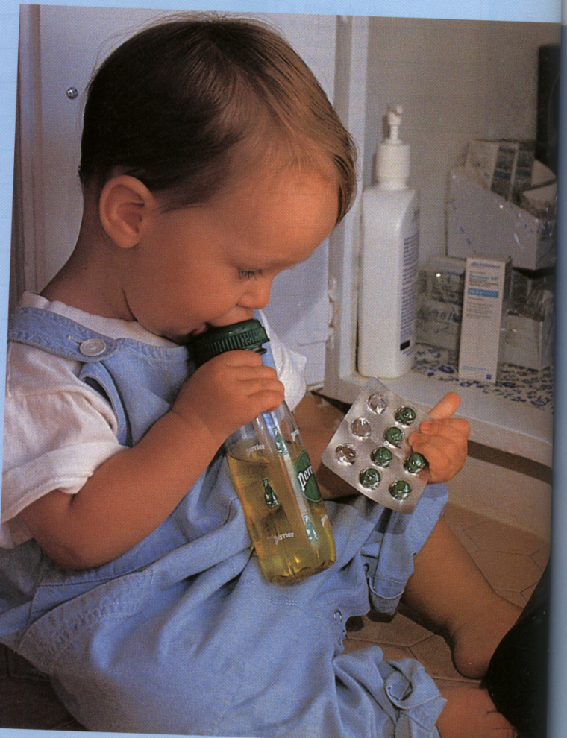
Foreign Body Airway Obstruction chocking

Slide 55
FBAO (Choking)
Epidemiology & Recognition
  More than 90% of deaths occur in children < 5 y/o.
  Signs: a sudden onset of respiratory distress with coughing, gagging, stridor, or wheezing

Slide 56
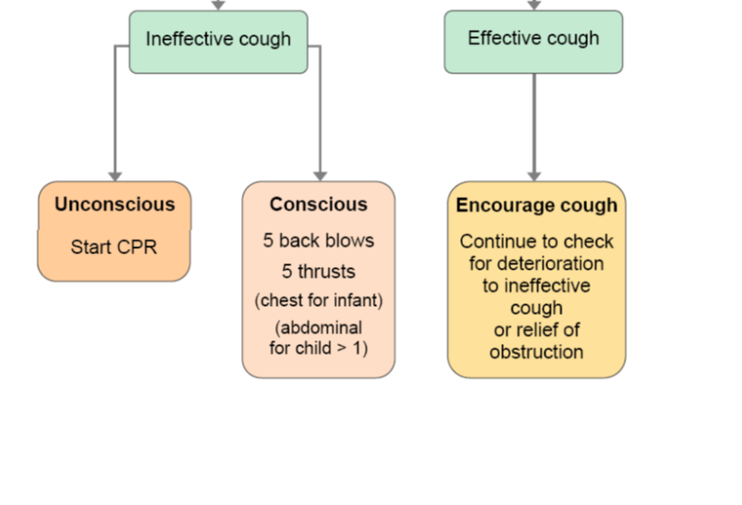
FBAO (Choking)
Mild airway obstruction
  The child can cough & make some sounds.
Severe airway obstruction
  The victim cannot cough or make any sound.

Slide 57
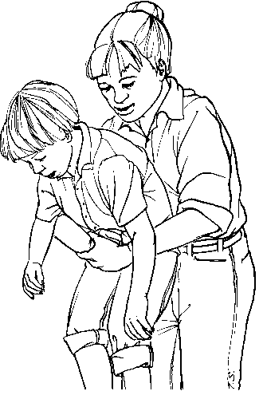
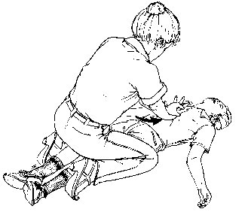
Heimlich maneuver
Conscious Child Standing
Conscious or Unconscious Child, Lying

Slide 58
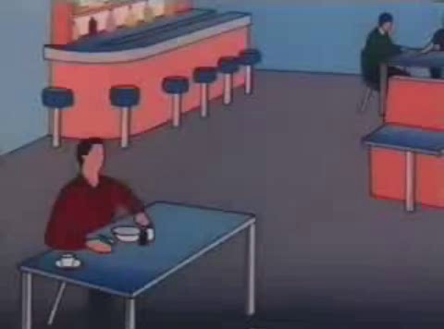

Slide 59
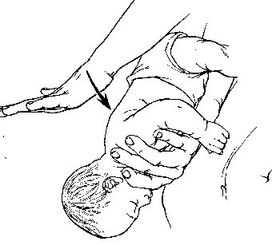
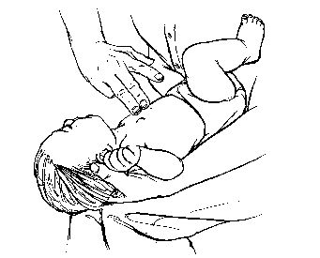
Back Blow & Chest Thrust in an Infant

Slide 60
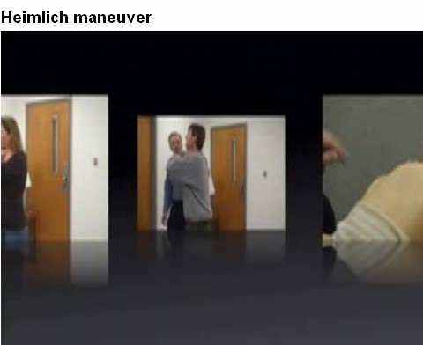

Slide 61
Unresponsive Victim
Perform CPR but should look into the mouth before giving breaths
  If you see a foreign body, remove it
  Do not perform blind finger sweeps because it may push obstructing objects further into the pharynx & may damage the oropharynx
  Attempt to remove an object only if you can see it in the pharynx
  Then attempt ventilation & follow with chest compressions

Slide 62
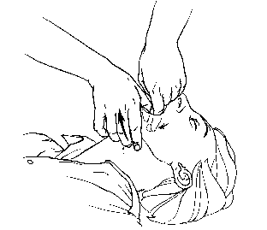
Finger Sweep Maneuver Administered to an Unconscious Victim of FBAO

